Slide 1
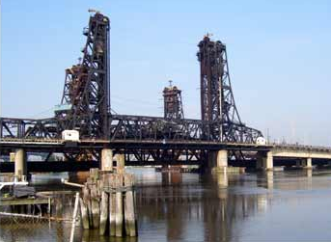
NCHRP 12-103 Phase II
Prestressed Girder Design

Slide 2
Demand Calculations
Cast in place connection for multi-span bridges
Dead Load -- spans act individually
Superimposed Dead Load -- spans act continuously
Live Load -- spans act continuously
Demand Calculation Methods
Single-line girder model for design
Bending moment in positive moment region
Shear and negative moment demands are set as capacity
(i.e. The strand design and connection are at margin)
FE beam member actions for settlement analysis

Slide 3
Member Sizing and Design
Section | Max Span (ft)
PCBT 29 | 60
PCBT 37 | 80
PCBT 45 | 100
PCBT 53 | 115
PCBT 61 | 125
PCBT 69 | 135
PCBT 77 | 145
PCBT 85 | 150
PCBT 93 | 155
PCBT Sections used
Based on VDOT specs
0.6” Dia. Strands used
Grade 270 low-relaxation strands
28 day f’c = 8ksi, 9ksi, 10ksi

Slide 4
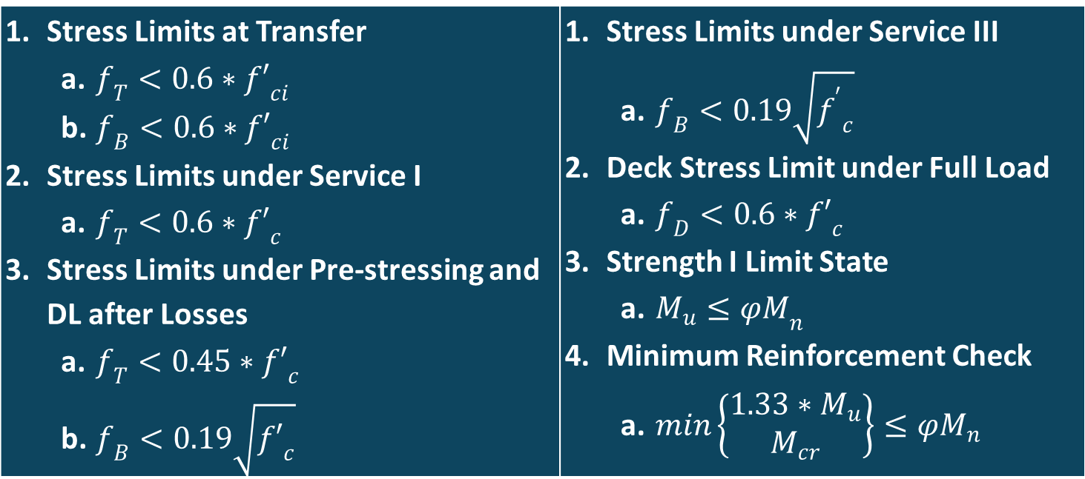
Design constraints and limit states
Every design must pass all constraints listed below:
Stress Limits at Transfer $f_{T}<0.6∗{f′}_{ci}$ $f_{B}<0.6∗{f′}_{ci}$ Stress Limits under Service I $f_{T}<0.6∗{f′}_{c}$ Stress Limits under Pre-stressing and DL after Losses $f_{T}<0.45∗{f′}_{c}$ $f_{B}<0.19\sqrt{{f′}_{c}}$ | Stress Limits under Service III $f_{B}<0.19\sqrt{{f^{′}}_{c}}$ Deck Stress Limit under Full Load $f_{D}<0.6∗{f′}_{c}$ Strength I Limit State $M_{u}≤{φM}_{n}$ Minimum Reinforcement Check $min\left\{\begin{matrix}1.33∗M_{u} \\ M_{cr}\end{matrix}\right\}≤φM_{n}$

Slide 5
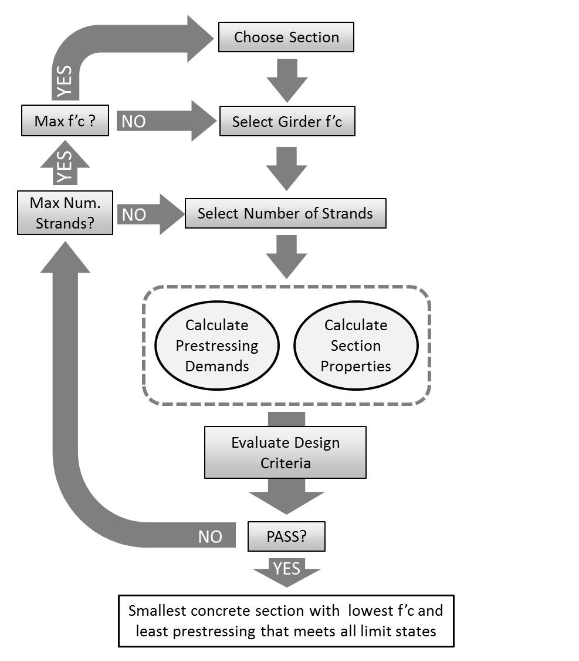
Iterative approach to girder design.
Section size and concrete strength set
Strands added until all constraints are met
If max number of strands are met before constraints
Increase concrete strength
Else, increase section

